Slide 1
SBOM Sprint #2
Thomas Eby, Pranav Gonepalli, Evan Hellersund, Manel Leong,
Camron Rule, Skyler Walker, Duohan Xu, Rachel Zheng
College of William & Mary
CSCI 435: Software Engineering
October 9, 2024

Slide 2
Sprint Goal
Set up the Django application
Communication between front end and back end
Formalize user stories and product backlog

Slide 3
Sprint Backlog
Create working Django application
Create initial frontend interface for file upload and display
Connect frontend and backend
Transmit SBOM file data between frontend and backend
Research vulnerabilities databases
Set up issue tracker

Slide 4
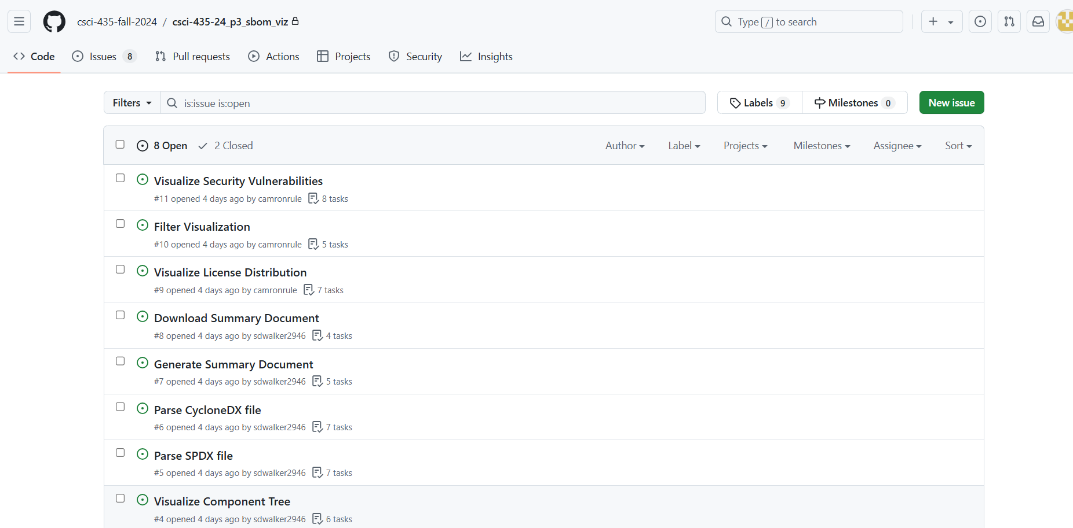
Issue Tracker

Slide 5
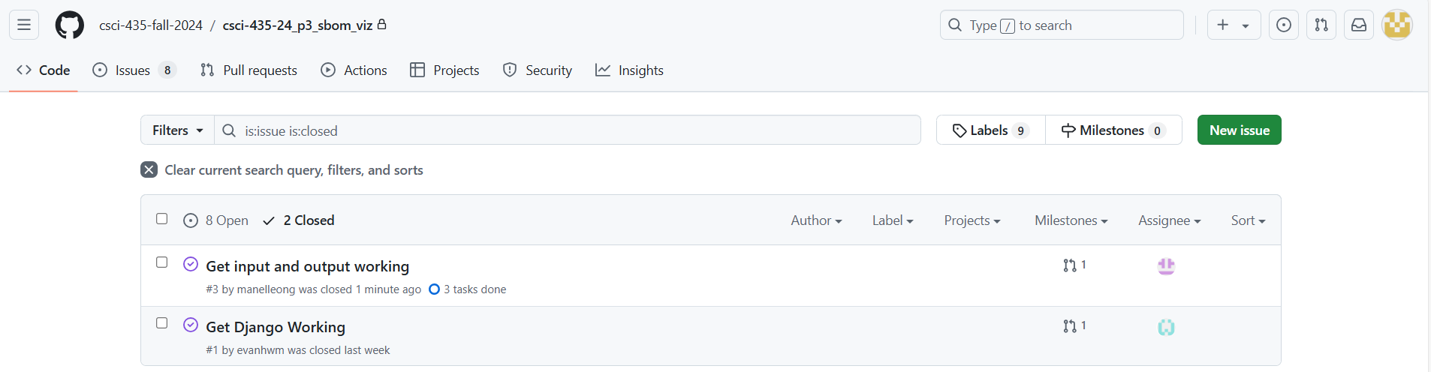
Issue Tracker (Continued)

Slide 6
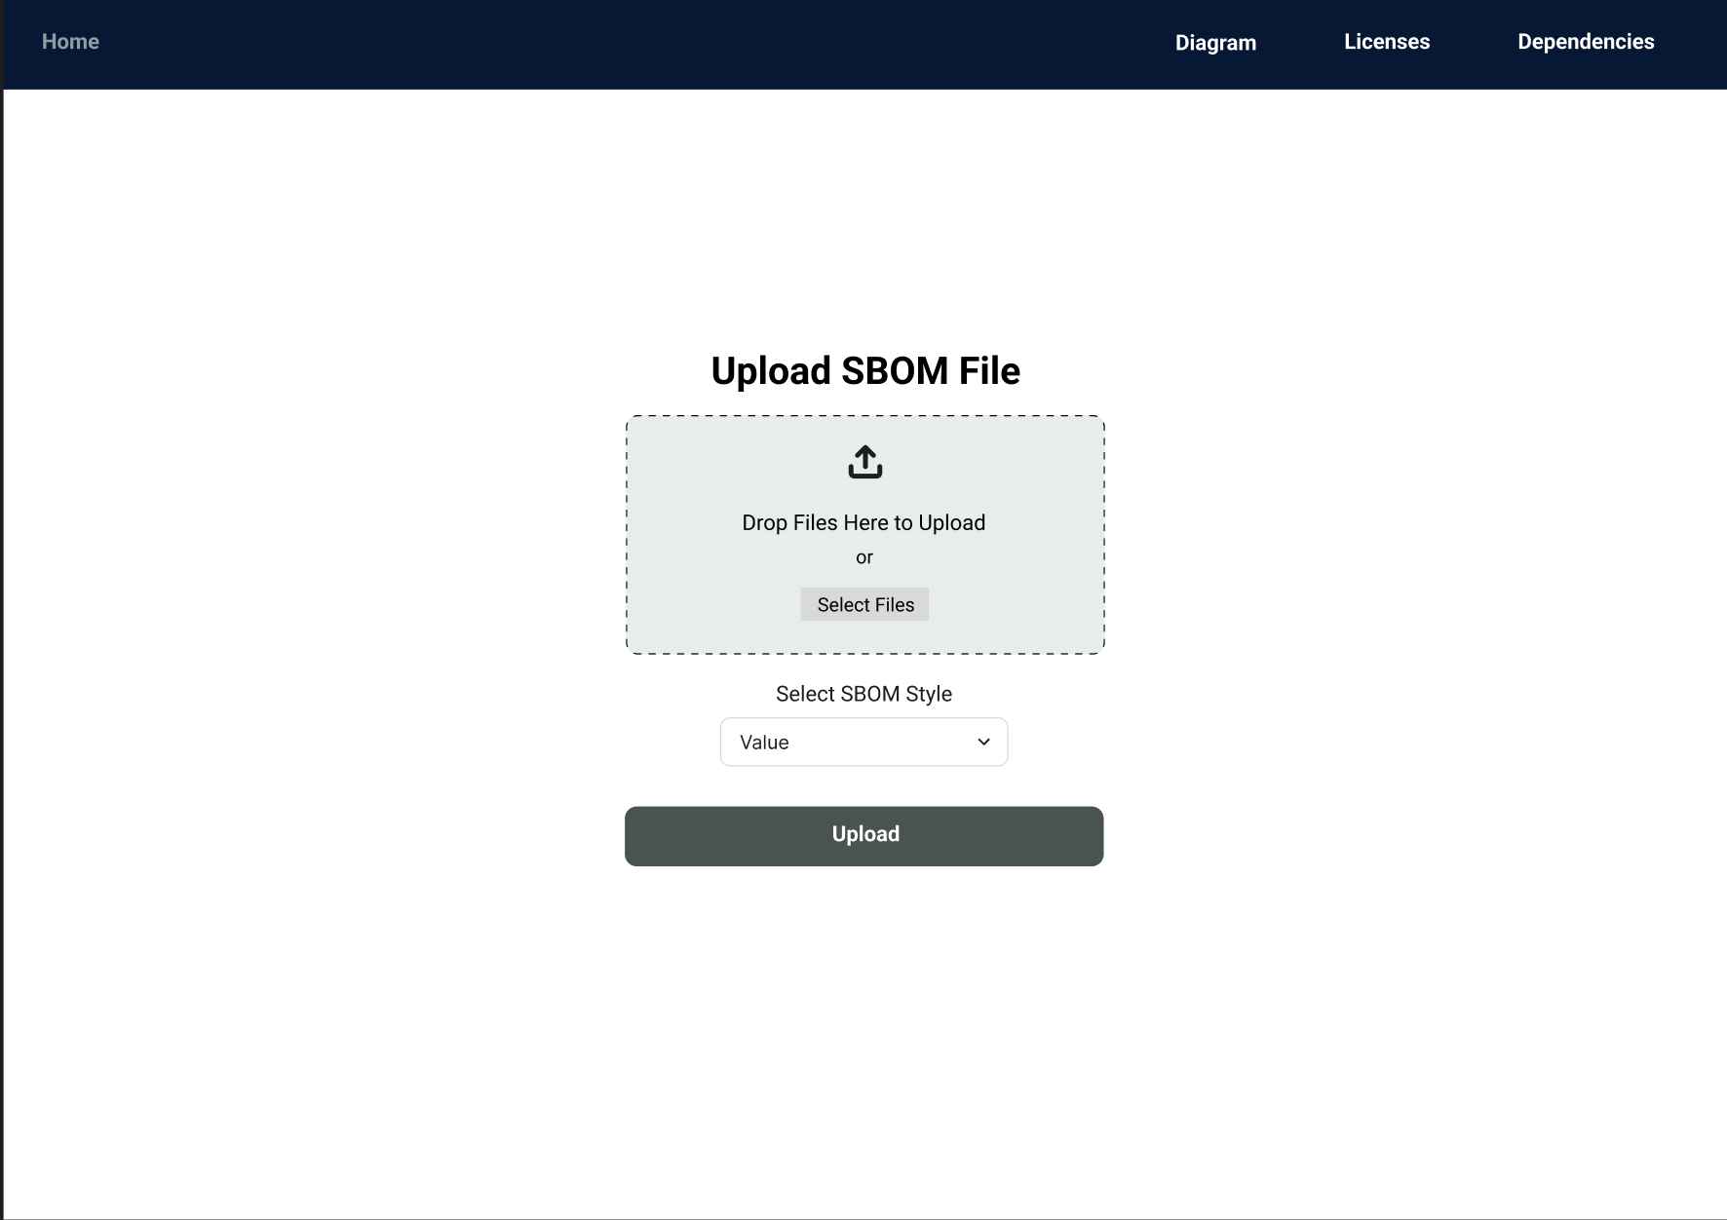
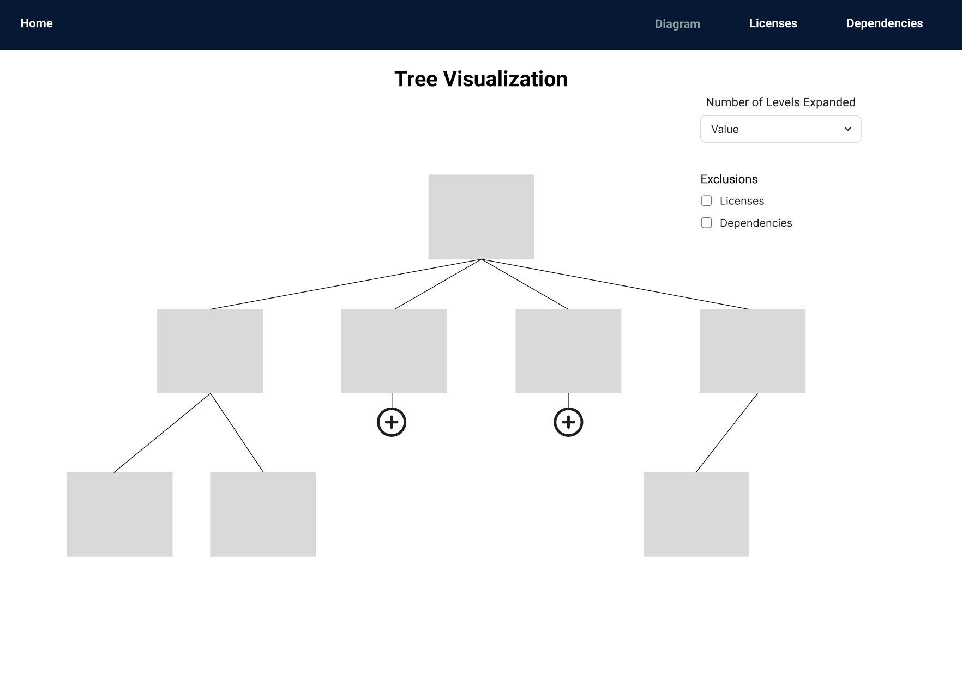
Design

Slide 7
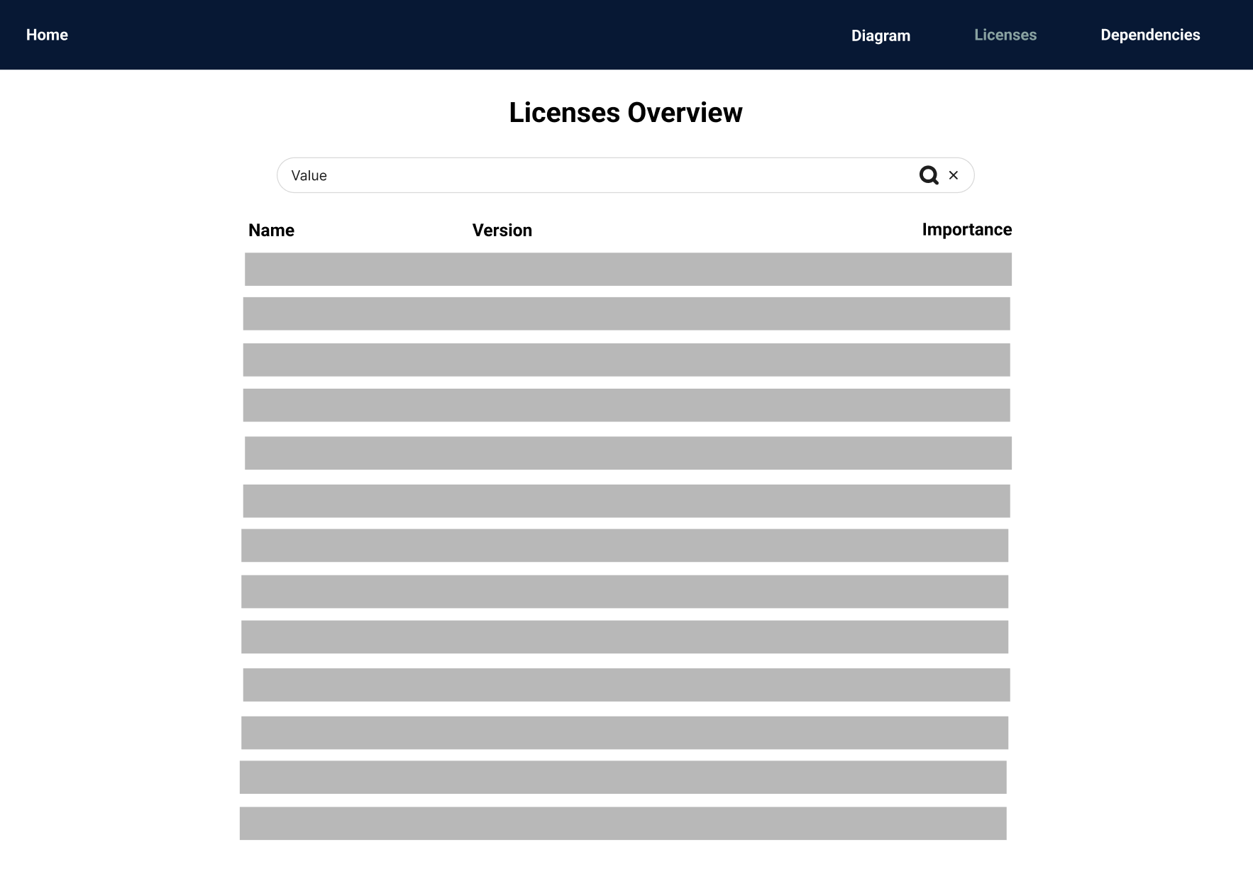
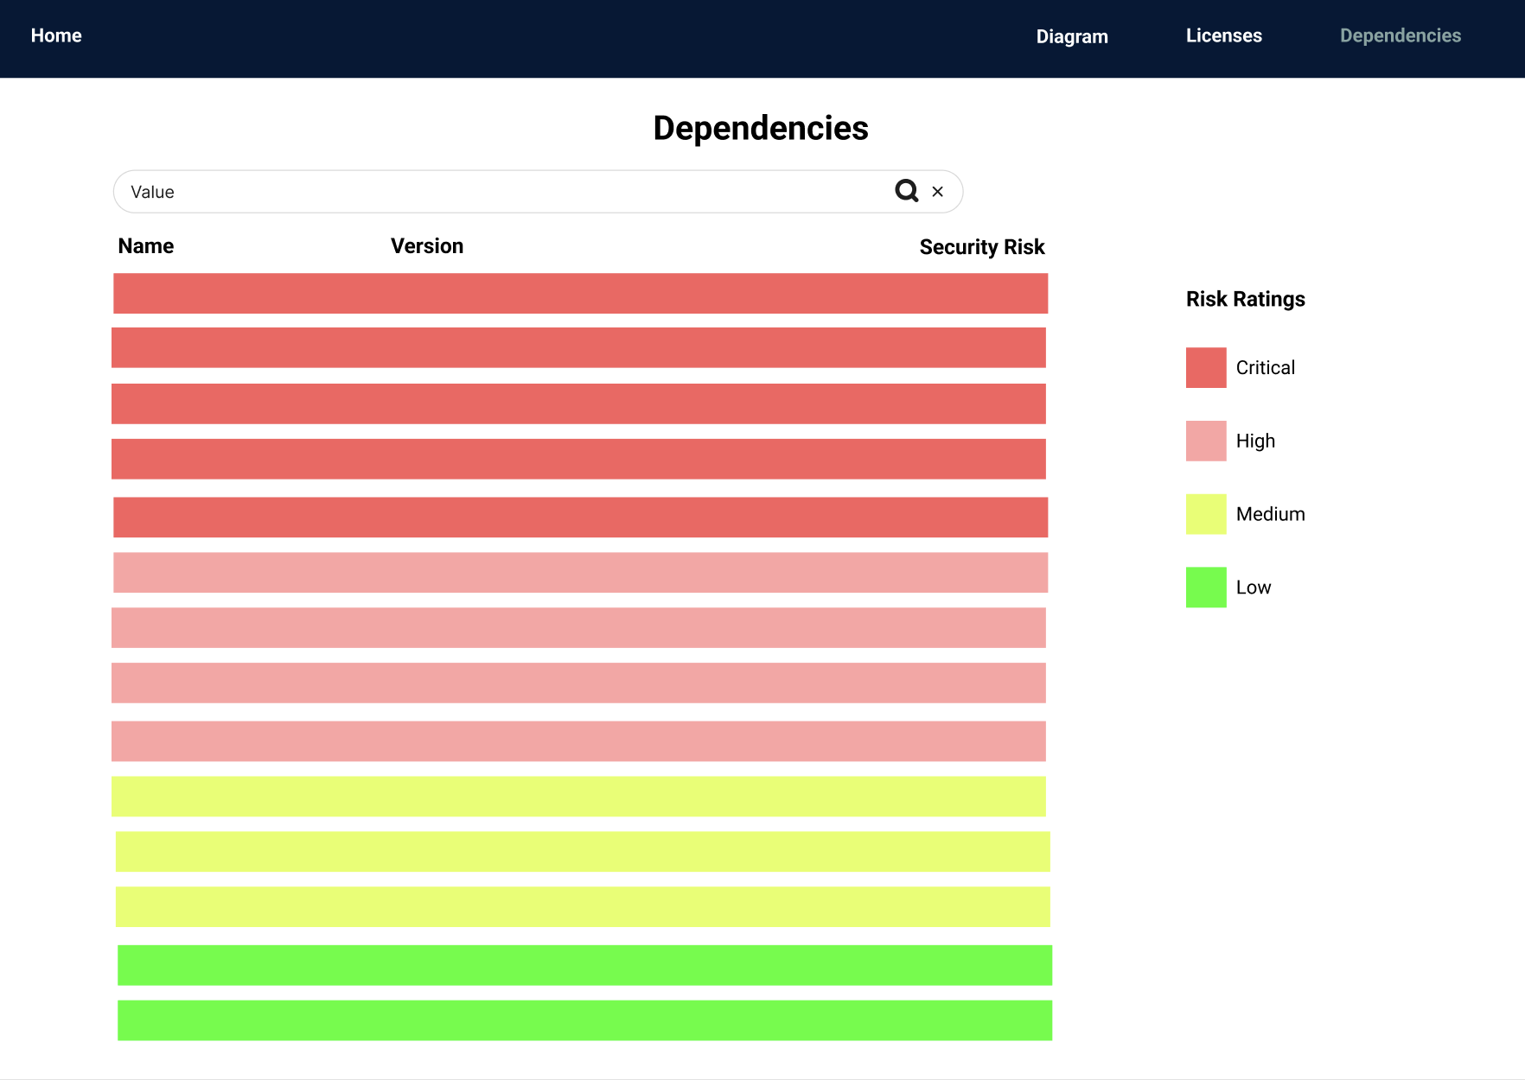
Design (Continued)

Slide 8
Security Vulnerability Databases | Licensing
CVE NIST National Vulnerability Database CISA Known Exploited Vulnerabilities Catalog | SPDX CycloneDX

Slide 9
Connecting to a Security Vulnerabilities Database
2 options:
National Vulnerability Database
Has an API and search (can filter by product, match by keyword, etc)
With API key: 50 requests/ 30 seconds; Without API key: 5 requests/ 30 seconds
Concerned with the amount of time it takes to query vulnerabilities for every component of the project
CVE
Has search, github of json files of all CVE

Slide 10
References
From https://github.com/CortezFrazierJr/my_recipe_book/blob/main/sampleCycloneDX.json:
CVE-2022-36077 is a vulnerability of pkg:npm/electron@11.1.1
CVE-2021-30518 is a vulnerability of pkg:npm/electron@11.1.1

Slide 11
More on NVD
Searching is slow but allows filtering by product which seems to be more effective in finding the vulnerabilities we want than a search by keyword
673 results with keyword search, 24 when searching by product (tested on electron package)
API seems to work faster but haven’t found a way to search by product
Sometimes hard to match package name on SBOM to cpe (naming convention on NVD)
Example:
electron > cpe:2.3:a:electronjs:electron:*:*:*:*:*:node.js:*:*
The example SBOM was also able to find outside dependents
One of the dependents of the electron package is chrome so the example SBOM(mentioned above) stated CVE-2021-30518 as a vulnerability of pkg:npm/electron@11.1.1
However, CVE-2021-30518 didn’t come up when searching by keyword or product on the word “electron” since nothing in the NVD page on CVE-2021-30518 specifically mentions electron

Slide 12
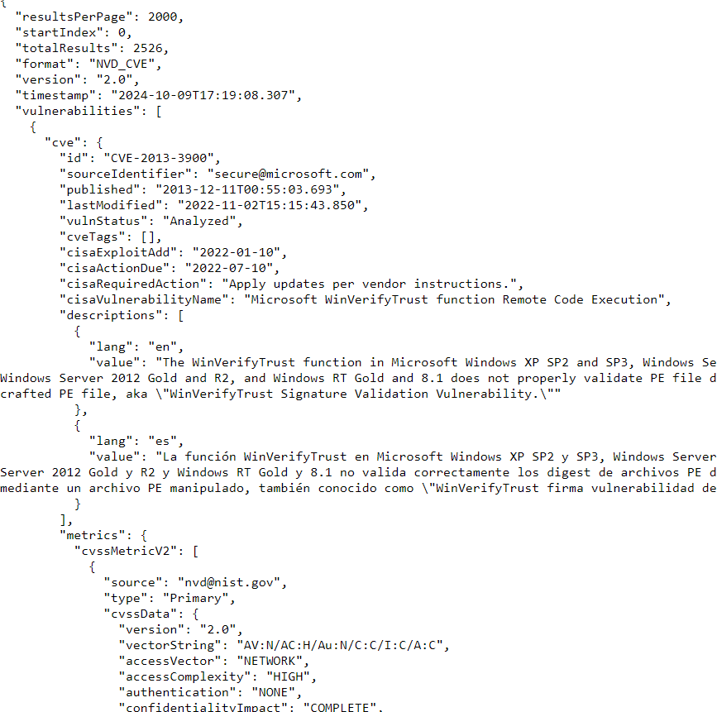
https://services.nvd.nist.gov/rest/json/cves/2.0?cpeName=cpe:2.3:o:microsoft:windows_10:1607:*:*:*:*:*:*:*
Example of Using NVD’s Rest API

Slide 13
More on CVE
Some files seem to be missing information like cvss scores
No search by product - return irrelevant results, but searching seems easier than on NVD

Slide 14
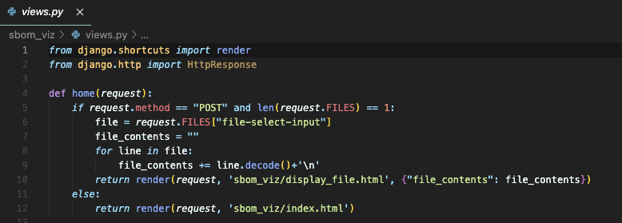
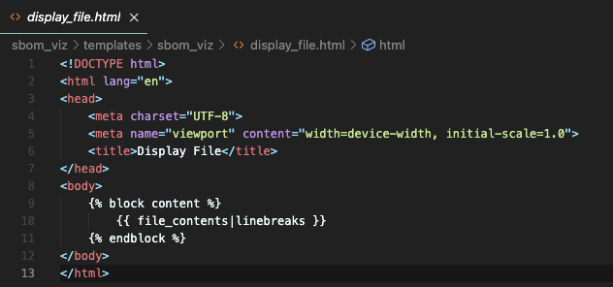
Current State of Project

Slide 15
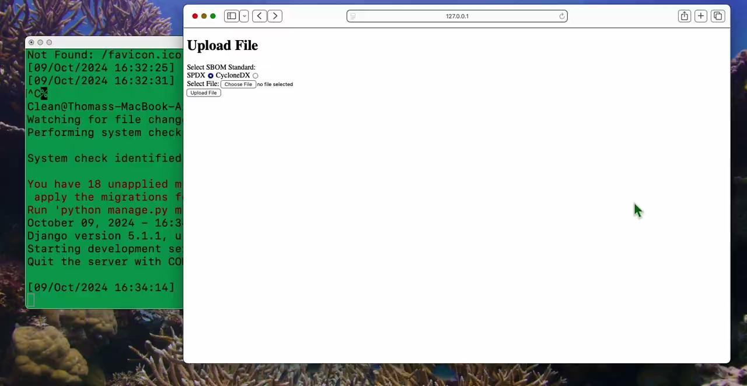
Demo

Slide 16
Next Sprint Backlog
Parse SPDX file and CycloneDX file
Being able to pass components from frontend to backend using HTTP requests and process SBOM data in the backend
Begin visualizing components as a tree

Slide 17
Lessons
Establishing a meeting plan
Identify most important topics before meeting
More comprehensive coverage of project priorities
Get everyone on the same page
Spur conversations about features
To fully utilize Django, we need to transition between HTML pages rather than using a single page approach with JavaScript controlling transitions

Slide 18
Contributions
Manel: Set up the project
Skyler: Implemented front-end interface for SBOM file upload and display, set up some issues in the issue tracker
Thomas: Linked the file upload to the backend and passed the contents back as a string
Pranav: Created website design
Camron: Contributed to user stories and GitHub issues
Rachel: Researched how to connect our project to the SVE database
Evan: Researched licensing and security databases
Duohan: Updated ReadMe, currently developing the SPDX parsing branch
Everyone: Contributed to user stories and the slideshow presentation.

